Slide 1
Topic: Ratios EQ: How to use ratios for a scale?
Year 11 Essentials

Slide 2
Things Required For This Lesson
Interactive Notebook
Textbook: Interleaved Maths Essential Connections
Ruler, Red Pen, Pencil, Pens, Scientific Calculator
Growth mindset

Slide 3

24
7
30
Topic: Ratios
Date: /03/2021
EQ: How to use ratios for a scale?
WICOR
This Photo by Unknown Author is licensed under CC BY-SA

Slide 4
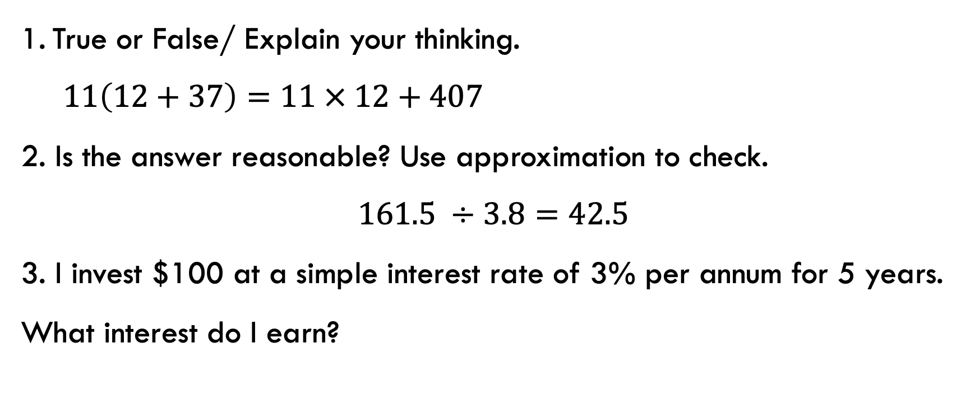
Topic: Ratios
EQ: How to use ratios for a scale?
Interleaved Questions
True or False/ Explain your thinking.
$11\left(12+37\right)=11 × 12+407$
2. Is the answer reasonable? Use approximation to check.
$$161.5 ÷3.8=42.5$$
3. I invest $100 at a simple interest rate of 3% per annum for 5 years. What interest do I earn?

Slide 5
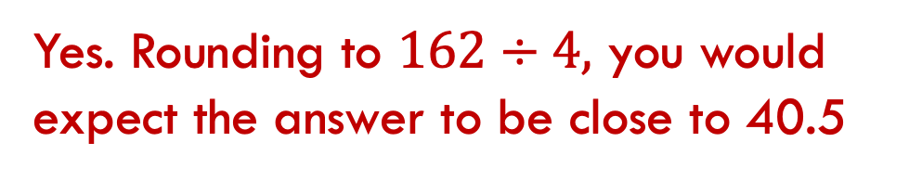
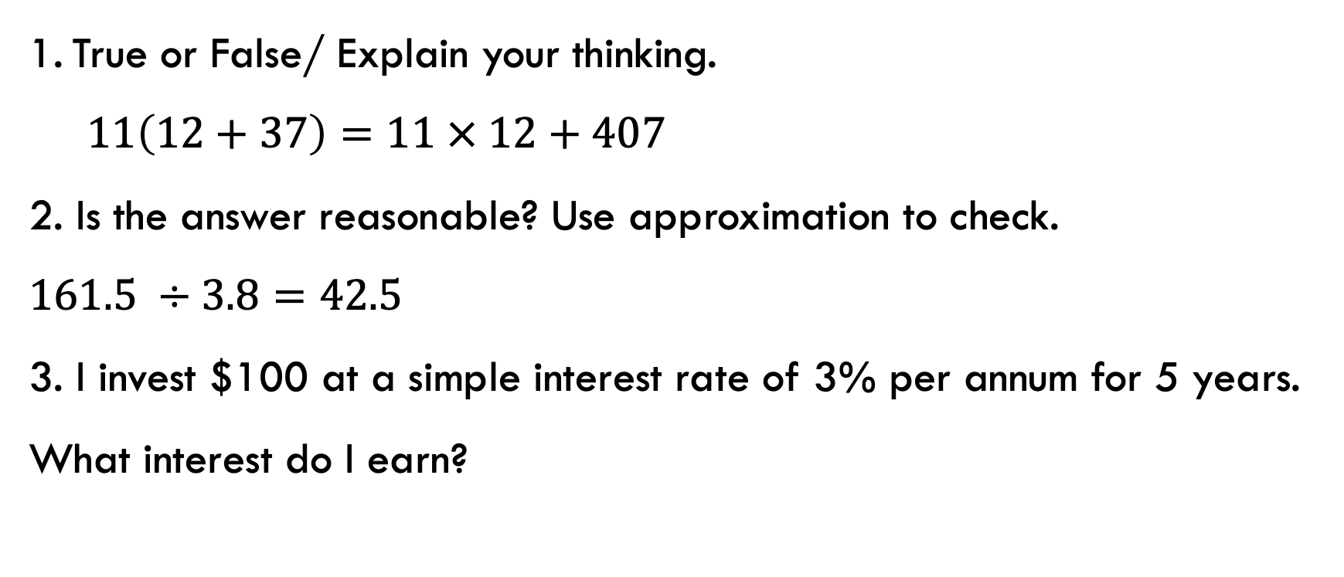
Topic: Ratios
EQ: How to use ratios for a scale?
Interleaved Questions
True or False/ Explain your thinking.
$11\left(12+37\right)=11 × 12+407$
2. Is the answer reasonable? Use approximation to check.
$161.5 ÷3.8=42.5$
3. I invest $100 at a simple interest rate of 3% per annum for 5 years. What interest do I earn?
True. Using distributive principle.
Yes. Rounding to $162÷4,$ you would expect the answer to be close to 40.5
$15.00

Slide 6
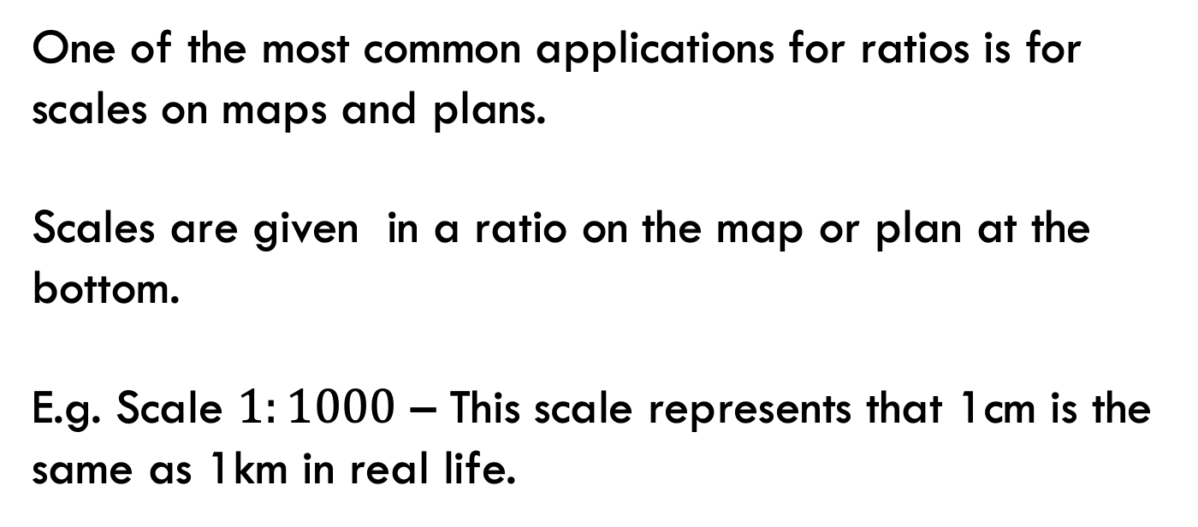
24
7
30
Topic: Ratios
EQ: How do I divide quantities into ratios?
Where do we use ratios?
One of the most common applications for ratios is for scales on maps and plans.
Scales are given in a ratio on the map or plan at the bottom.
E.g. Scale $1:1000$ – This scale represents that 1cm is the same as 1km in real life.
WICOR

Slide 7
Think pair share
1. Make a list of where you find ratios.
Boys to Girls in Classrooms
Cooking
Sports, e.g. win to loss
Maps
Floor Plan – Architect

Slide 8
Practice: (LSH)
Task
1. Complete set A: Practice and application questions on page 34.

Slide 9
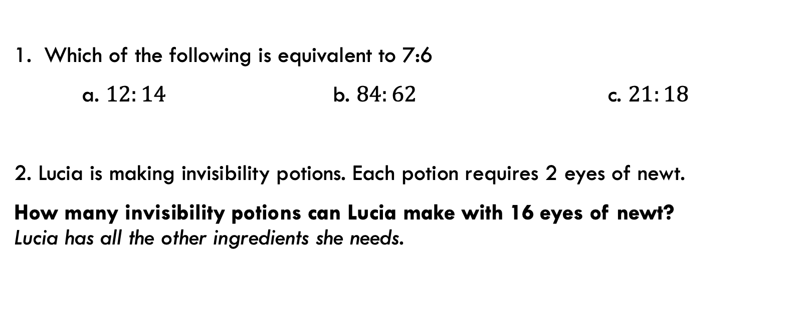
Exit Pass
1. Which of the following is equivalent to 7:6
a. $12:14$ b. $84:62$ c. $21:18$
2. Lucia is making invisibility potions. Each potion requires 2 eyes of newt.
How many invisibility potions can Lucia make with 16 eyes of newt? Lucia has all the other ingredients she needs.

Slide 10

Thank you
Keep up the good work!
”The Best way to predict the future is to create it.”
-Abraham Lincoln

